Slide 1


Chrome dev tools for HTML

Slide 2

Topics
Introduction to Chrome dev tools for HTML
Inspecting and modifying HTML elements
Viewing and editing elements attributes
Understanding the HTML DOM structure
Testing and debugging form elements
Accessibility auditing and testing

Slide 3

Introduction to Chrome dev tools for HTML
Chrome DevTools is a powerful set of web development and debugging tools built into the Google Chrome browser.
Different ways to open Chrome Dev tools
Manually and with shortcut keys

Slide 4
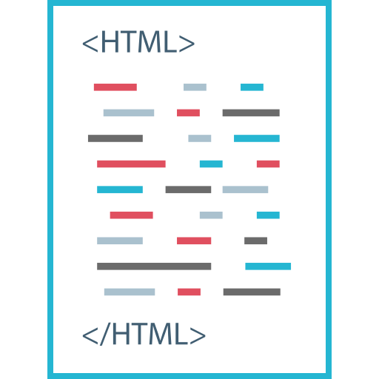
Inspecting and Modifying HTML elements

Slide 5

Viewing and editing element attributes

Slide 6
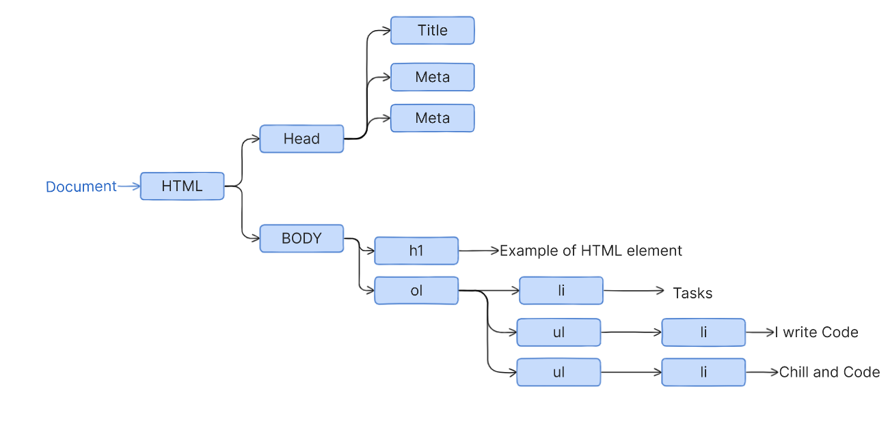
Understanding the HTML DOM Structure
The HTML DOM (Document Object Model) is a programming interface for HTML and XML documents.
<!DOCTYPE html>
<html lang="en">
<head>
<meta charset="UTF-8" />
<meta name="viewport" content="width=device-width, initial-scale=1.0" />
<title>Document</title></head>
<body>
<h1>Example of HTML element</h1>
<ol><li>Tasks</li>
<ul>
<li>I write Code</li>
</ul>
<ul>
<li>Chill and Code</li>
</ul></ol>
</body>
</html>

Slide 7

Testing and Debugging Form elements

Slide 8

Accessibility auditing and testing

Slide 9

THANK YOU

